Slide 1
Numbers up to 200

Slide 2
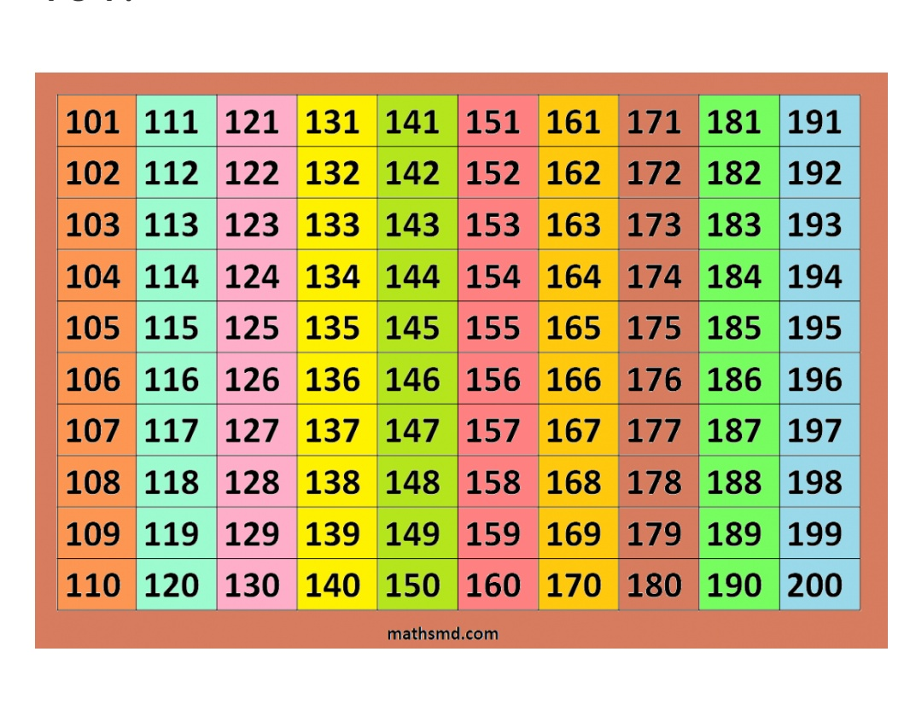

Slide 5
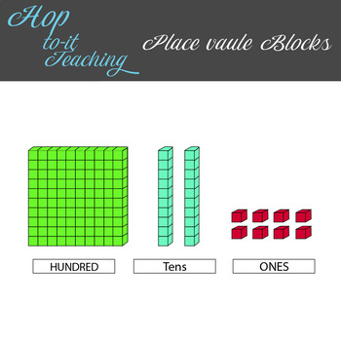

Slide 6
